Slide 1
Bay House Sixth Form
Information Evening

Slide 2
100% A* - E (nat : 97%)
90% A* - C (nat : 76%)
70% A* - B (nat : 52%)
38% A*/A (nat: 25%)

Slide 3
A copy of this PowerPoint presentation, along with an email contact sheet for the Sixth Form team, tutors & subject leaders, can be found at: ‘Letters & Resources’ section of Sixth Form website
‘Top Tips’ for success at AS can be found at: ‘Course Information’ section of Sixth Form website

Slide 4


Slide 5
Students who succeed:
Recognise the challenge from day 1
Actively seek help when they do not understand something
Commit to sufficient home learning
Do more than the bare minimum
Persevere when things get tough
Have excellent attendance records

Slide 6
Clarification of home learning
LOWER Sixth (4 courses)
50 period fortnight
36 lessons
8 study periods
6 ‘frees’
4-5 hrs HL per week per subject
=16-20 hrs per week

Slide 7
The year ahead:
Interim reports: w/c 25 November
Tutor Parents’ Evening: 28 November
Full Parents’ Evening: 6 February
Mini mock window: End Dec/Early Jan
Mock exam week: w/c 24 February

Slide 8
1 = always, 2 = usually, 3 = sometimes, 4 = rarely, 5 = never
Interim Report
 | Target Grade | Teacher | Focused and attentive in lessons | Arrives to lessons with correct resources | Contributes positively to class activities | Files/notes are well organised and suitably detailed | Assessed work suggests student is on track to meet target grade | Meets home learning deadlines | Submits home learning of expected standard
English | A2 | JE | 2 | 3 | 4 | 3 | 4 | 3 | 3
 |  | GT | 1 | 2 | 2 | 2 | 2 | 2 | 2
Mathematics | B1 | LN | 1 | 1 | 1 | 1 | 1 | 1 | 1
 |  | SP | 1 | 1 | 1 | 1 | 1 | 1 | 1
Biology | B1 | WF | 1 | 1 | 1 | 1 | 1 | 1 | 1
 |  | NG | 1 | 2 | 4 | 2 | 2 | 2 | 2
Physical Education | A2 | JW | 3 | 2 | 2 | 2 | 2 | 2 | 2
 |  | SO | 2 | 1 | 1 | 1 | 1 | 1 | 2

Slide 9
The year ahead:
Full reports: w/c 30 March
Lower Sixth Exams: 8 June (provisional)
Upper lessons begin: 23 June (provisional)
Year ends: 21 July

Slide 10
Dropping a subject:
Mini Mock – January
Full Mock – March
Lower Sixth Examinations - July

Slide 11
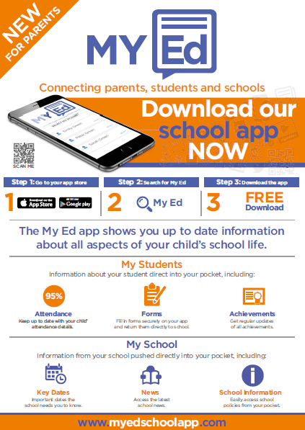
Links to important information on website
Messaging portal
Attendance
Absence – allows you to view & account for unexplained absences
Student’s Timetable
Forms – electronic copies of various communications sent home
Progress report – data will be uploaded to the app on a termly basis
‘MY Ed’ APP – CONNECTING PARENTS, STUDENTS AND SCHOOLS
Parents/carers are encouraged to download to access:

Slide 12
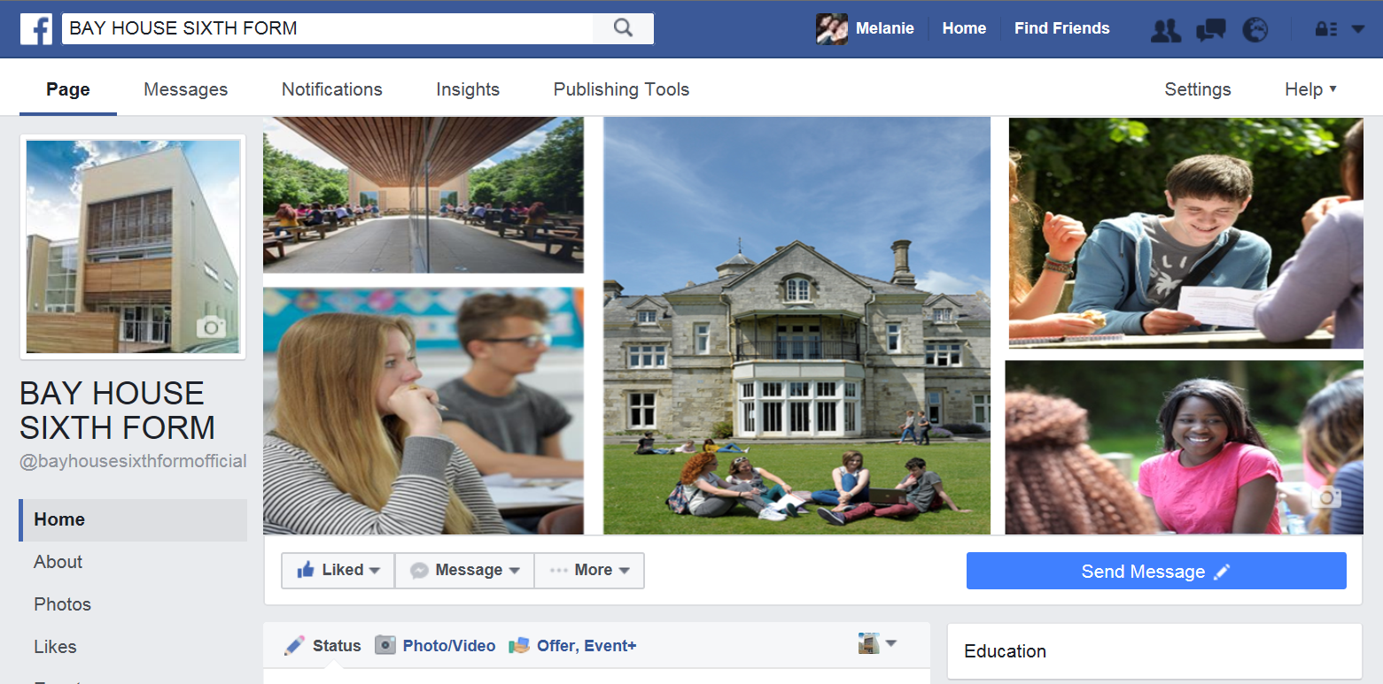
Facebook Page
www.facebook.com/bayhousesixthformofficial
Lots of useful information/reminders relevant to Sixth Form parents/students can be found here. Please ‘like’ and encourage your son/daughter to do so too!

Slide 13
Bay House Sixth Form
Information Evening

Slide 14
How to succeed in Maths and Further Maths

Slide 15
Content keeps building on the work being taught, so if anything is not understood, seek help straight away
Learn key formulae as you go – even though you get a formula book in the exam, it contains very little

Slide 16
When missing a lesson…
Catch up with any work missed in advance of the next lesson
Staff can be found before and after college along with break and lunchtimes
Use the many useful websites that are out there to help – using the worked solutions online is useful but will not help achieve top grades

Slide 17
Start revising early and use practice exam papers and questions to revise
Ensure that all working and diagrams are clearly shown in order to maximise marks
Go back over any corrections that have to be made in any work completed

Slide 18
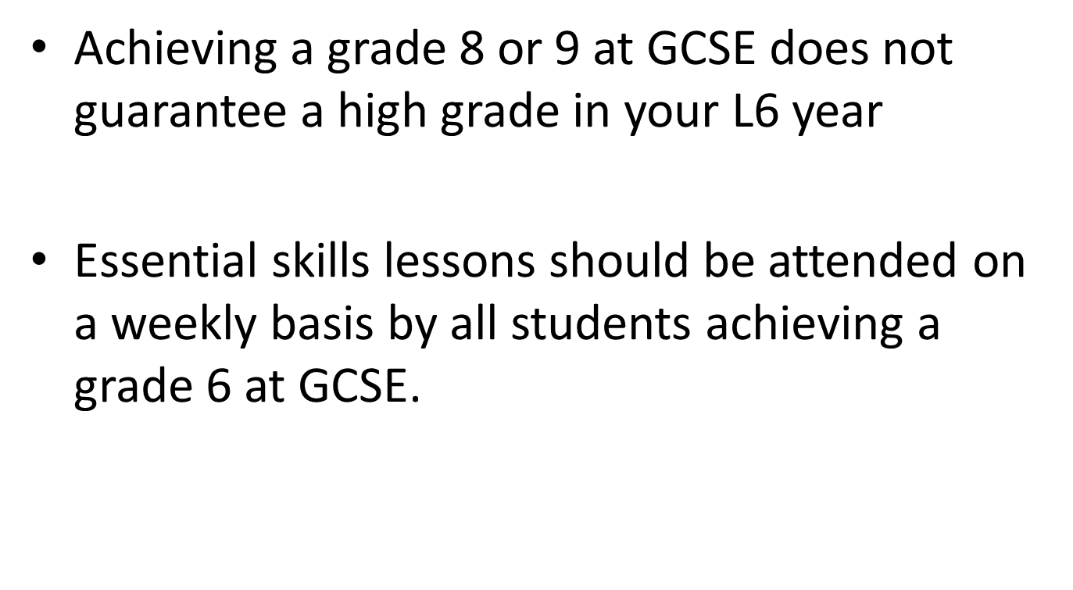

Slide 19
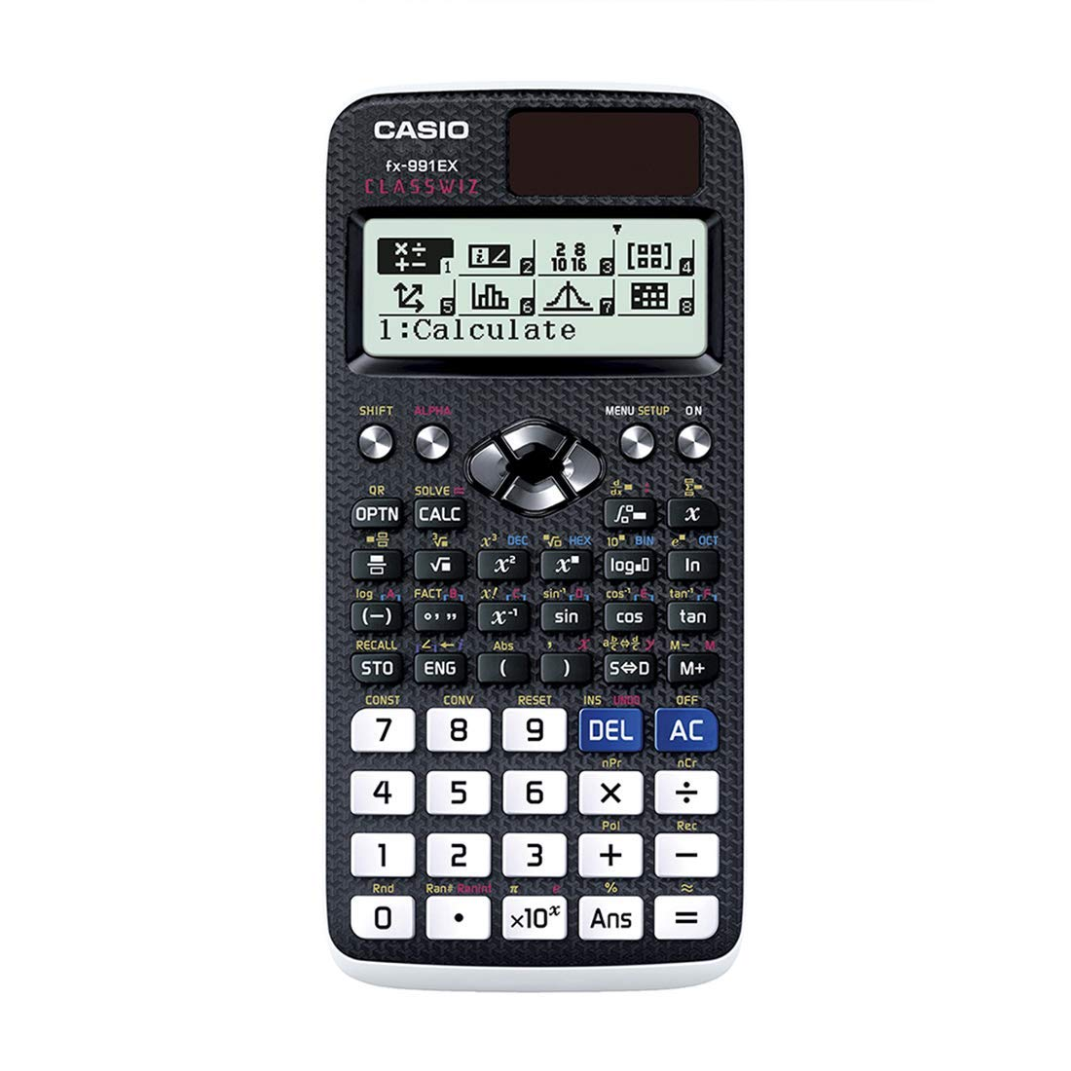
Ensure you have the correct equipment
The new exam requires a Casio Classwiz Fx-991ex calculator (£20 at the Finance Office)

